Slide 1


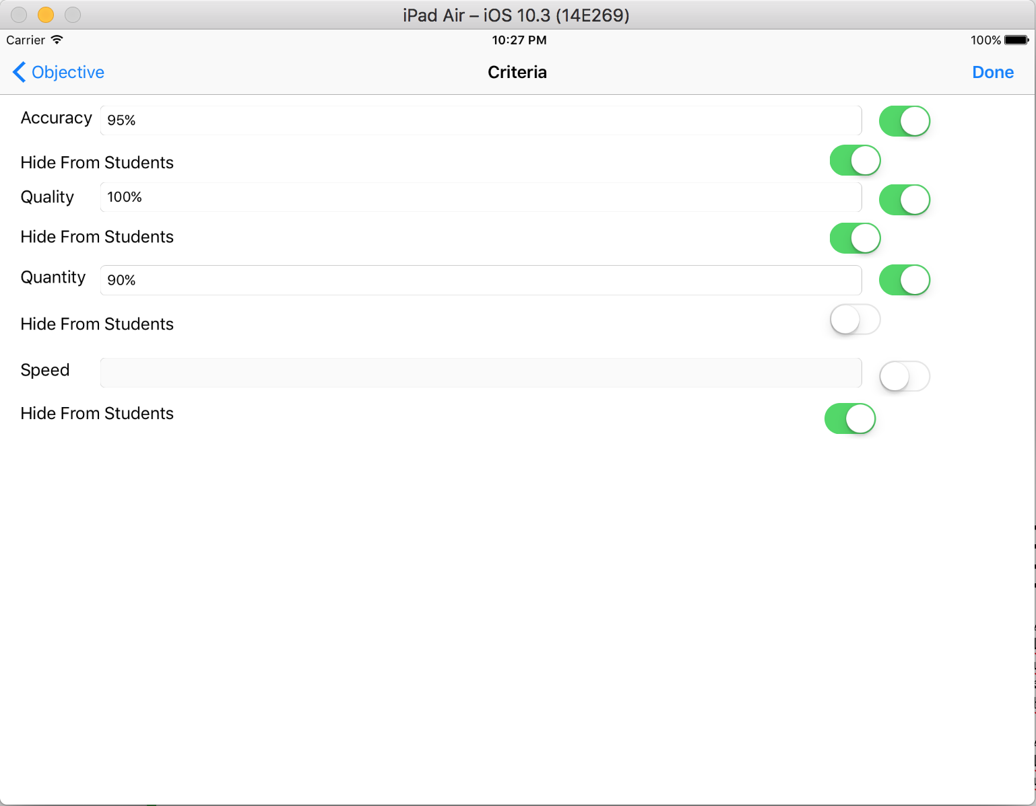
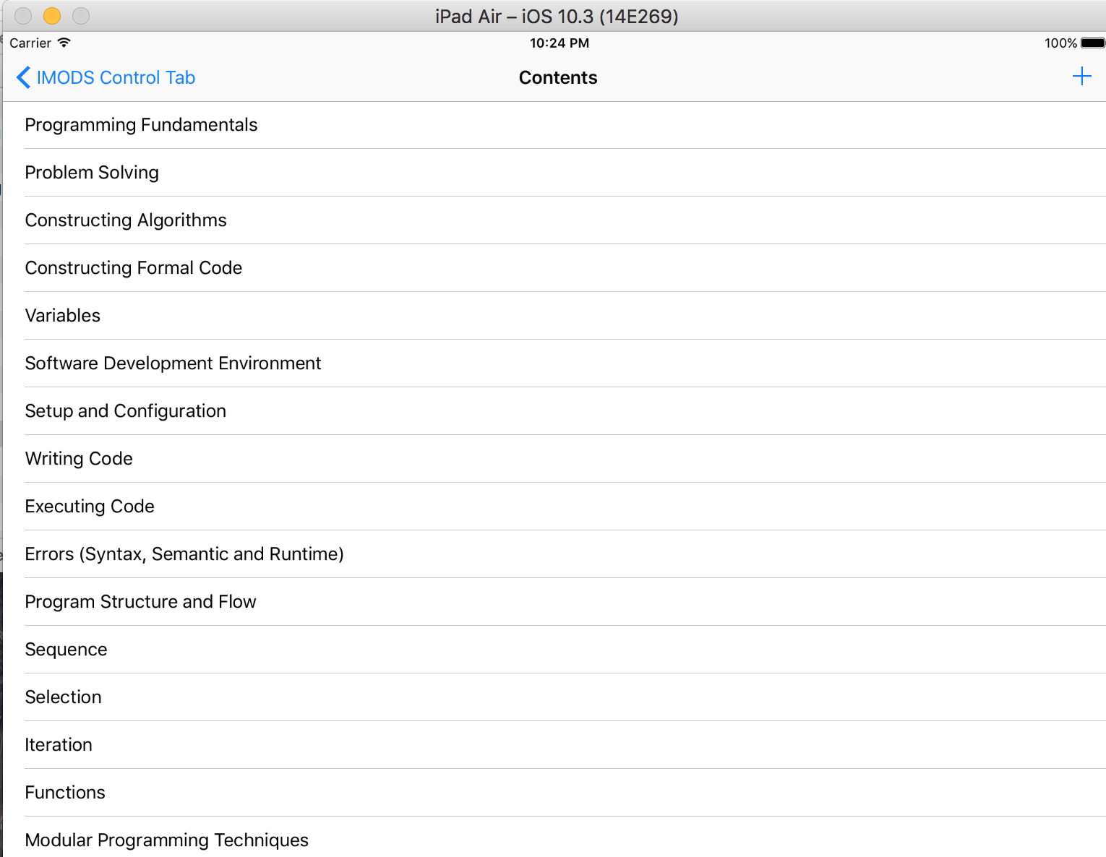
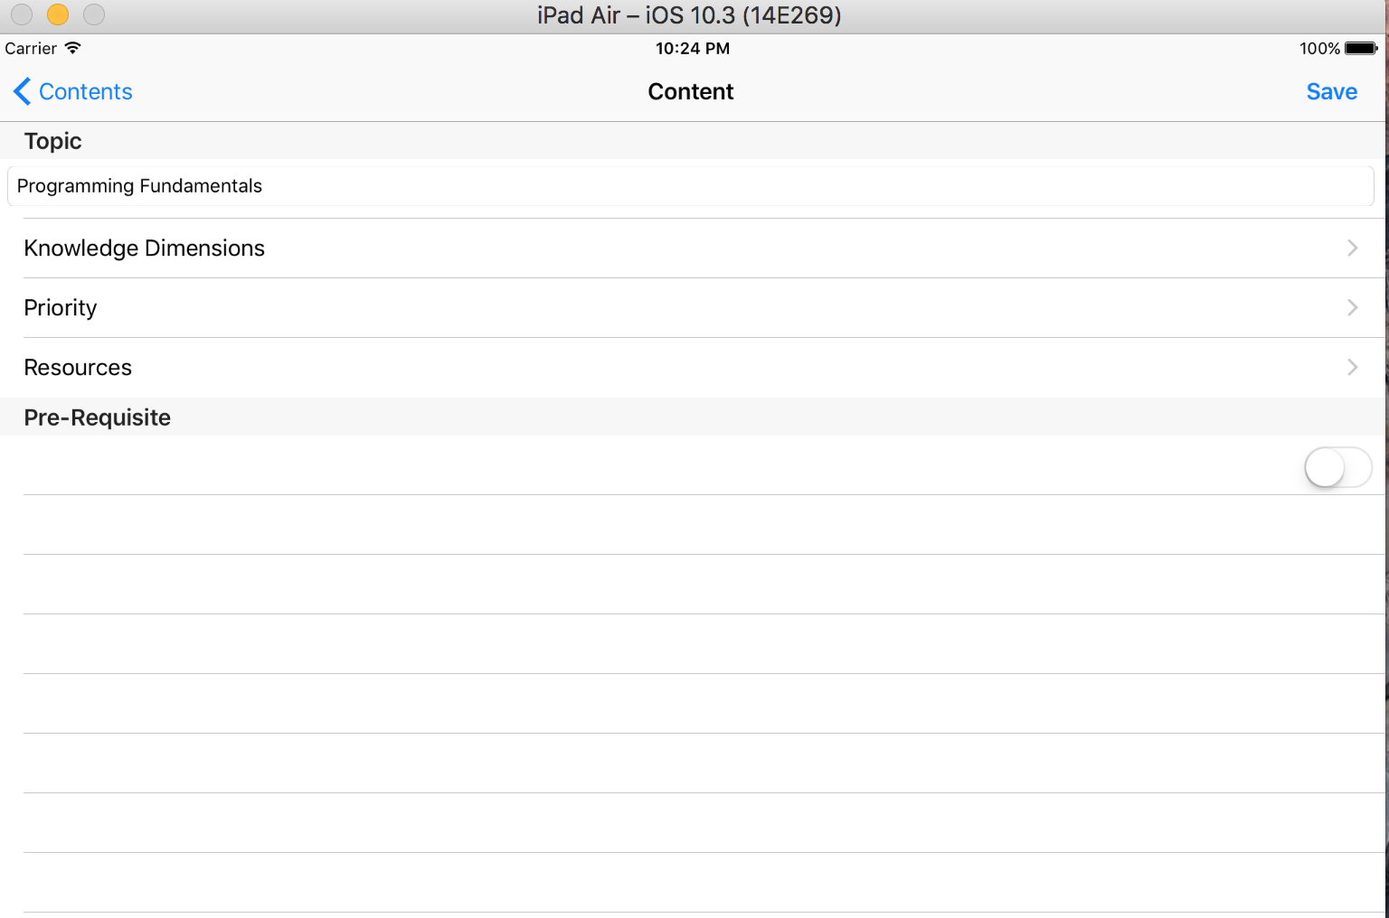
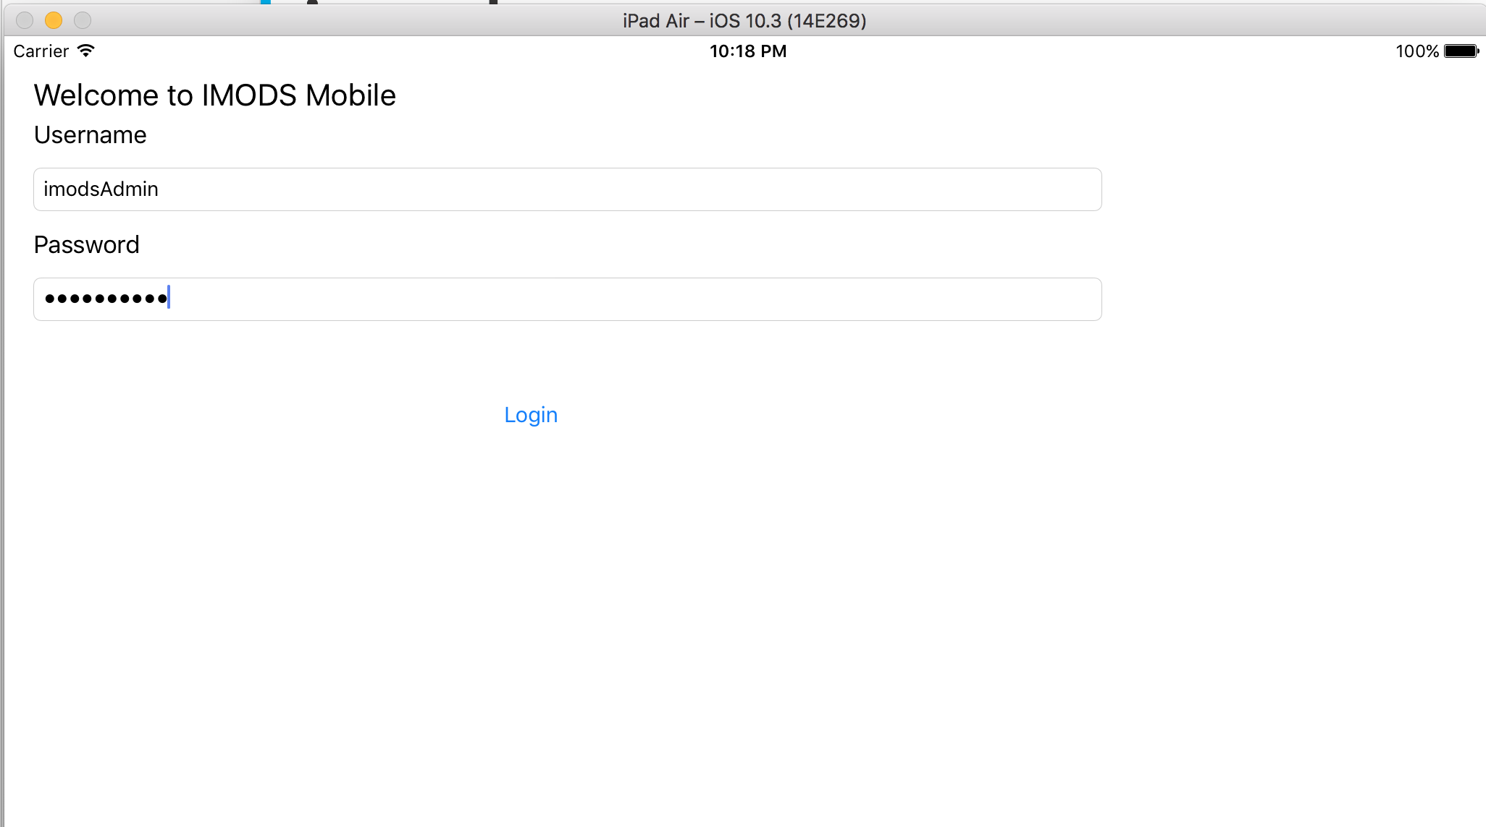
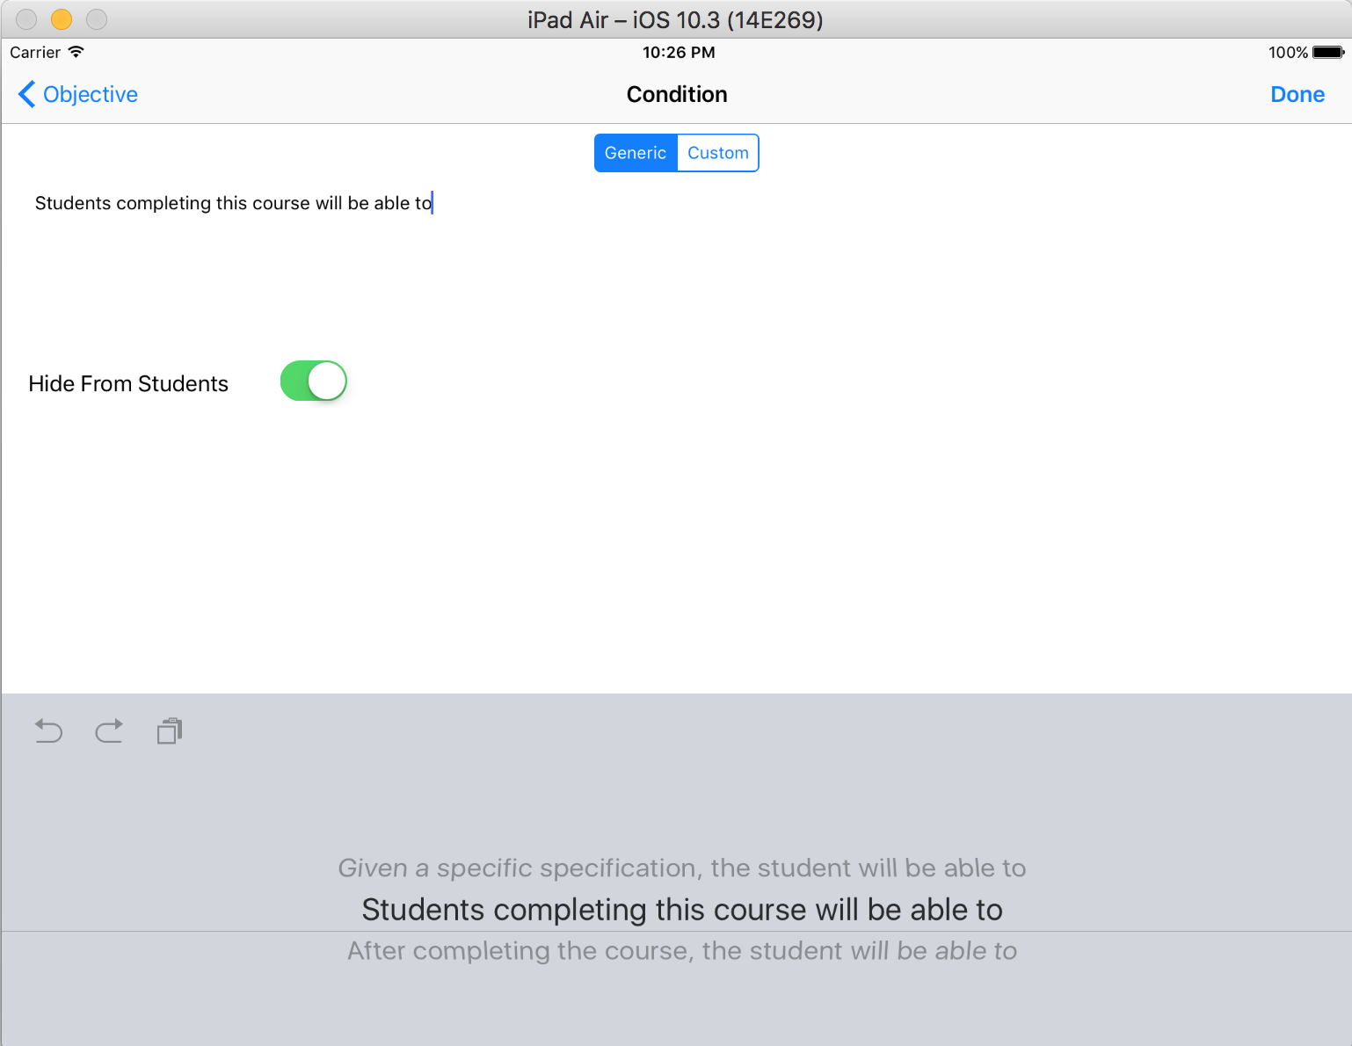
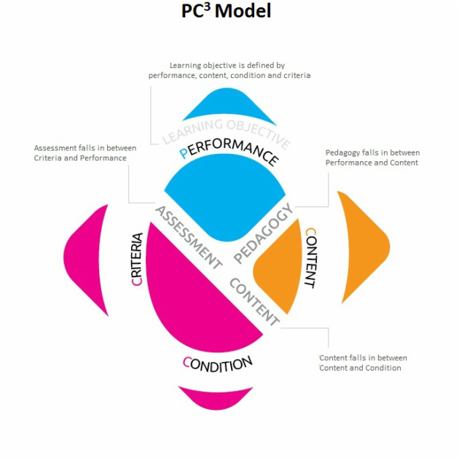
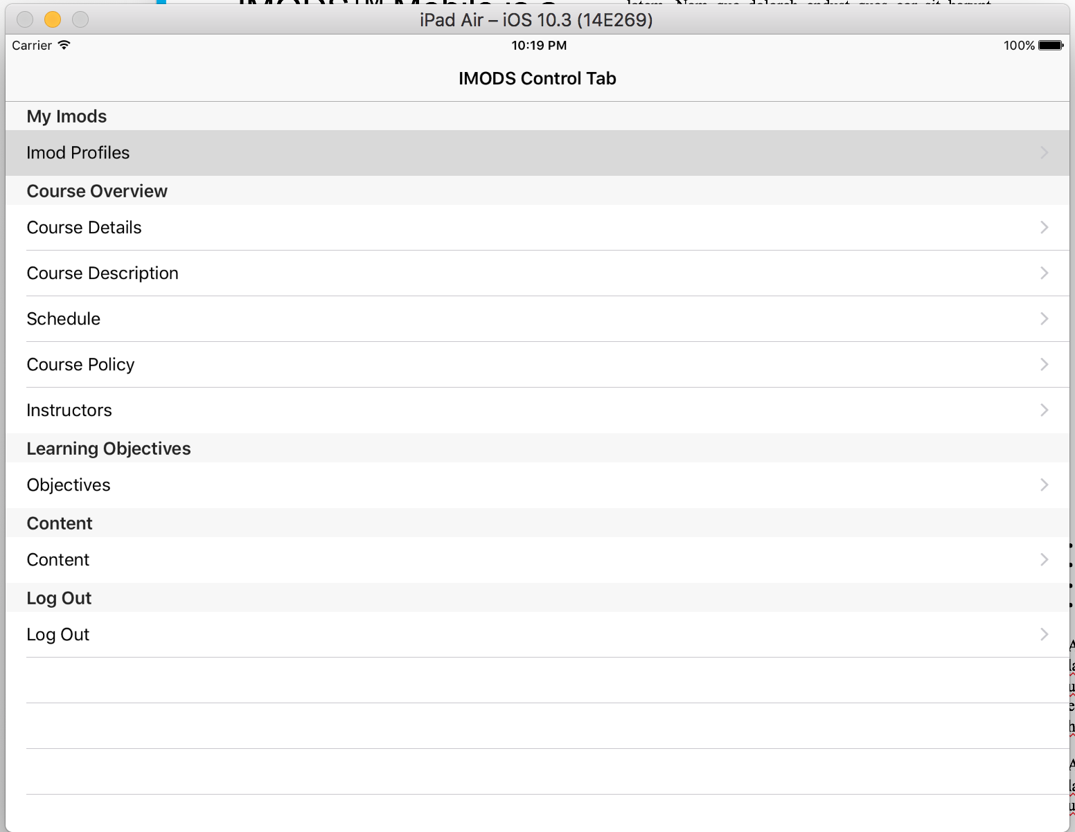
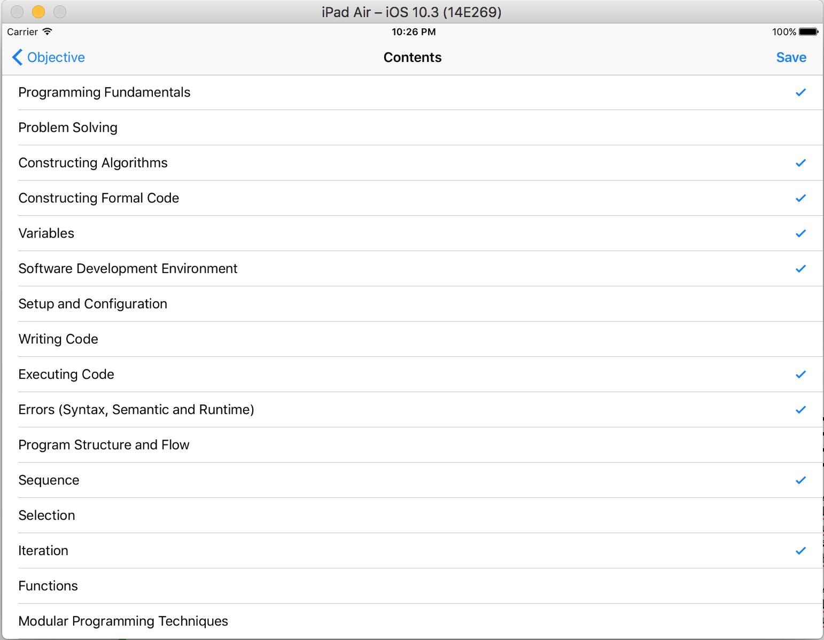
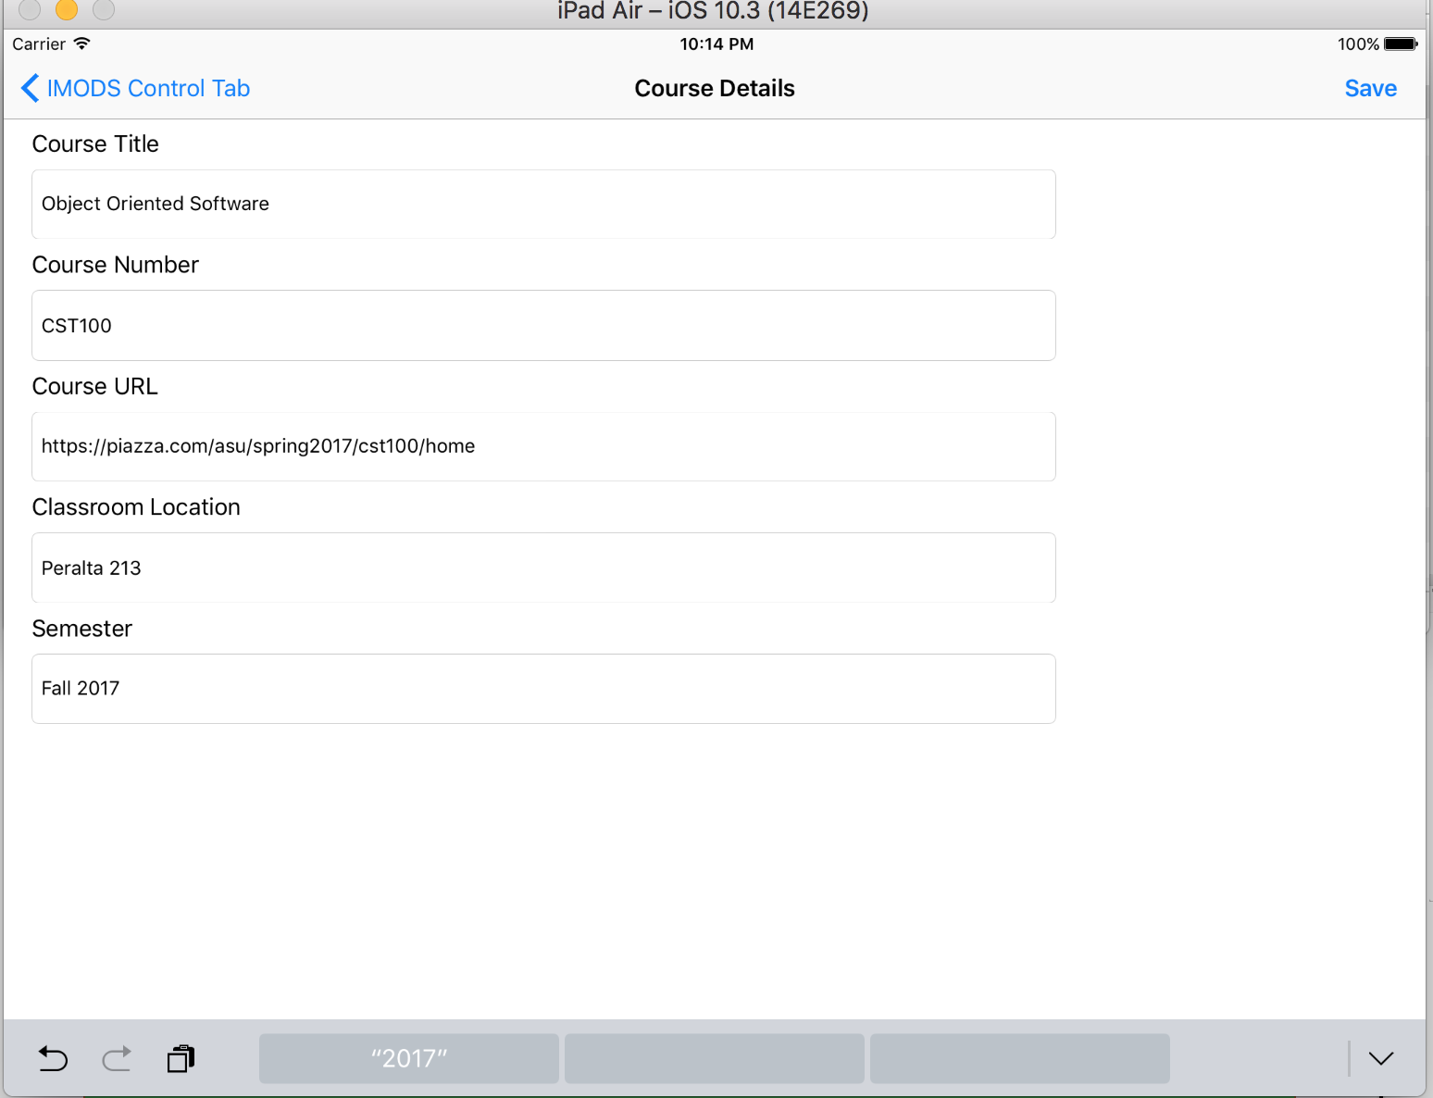
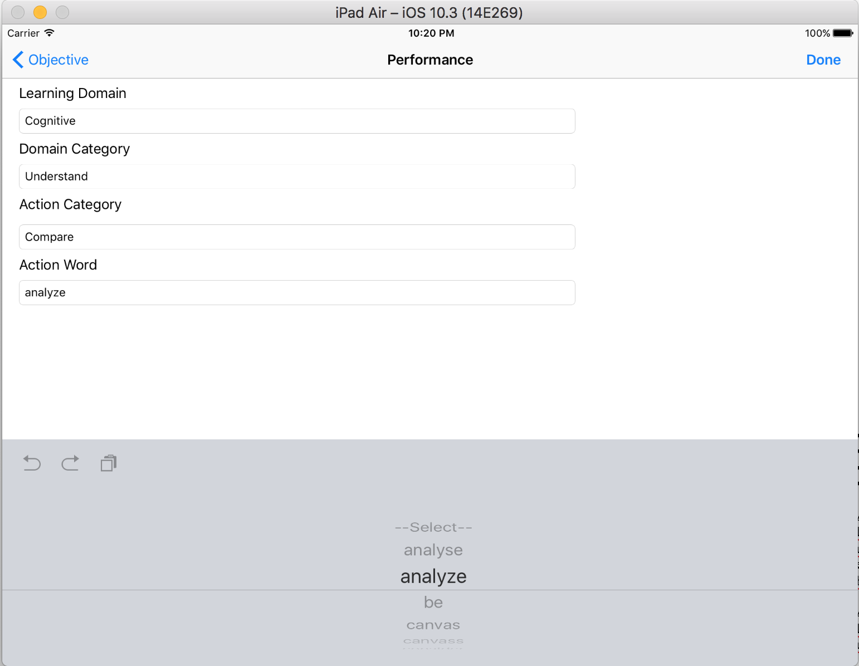
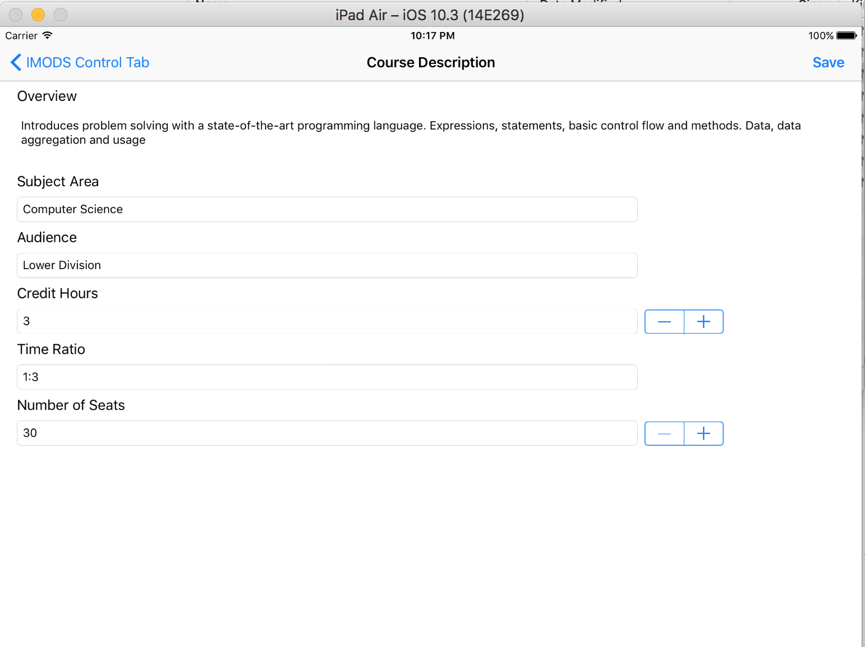
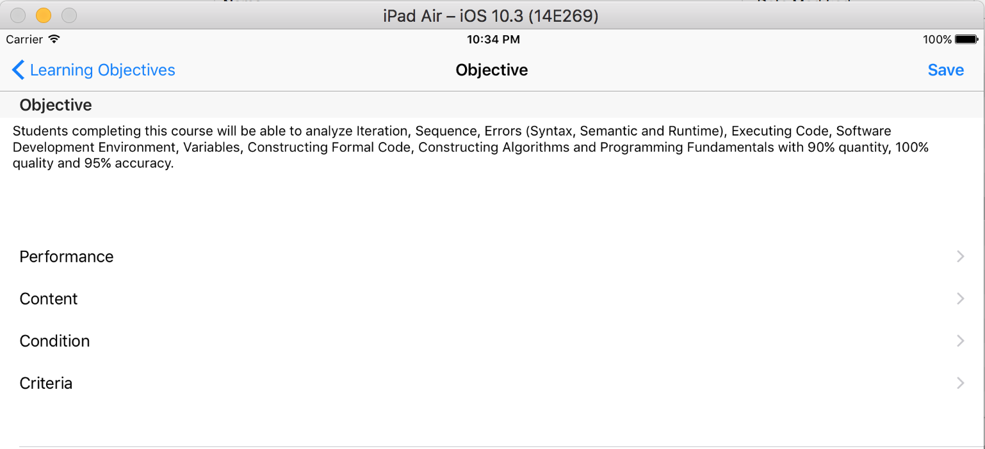
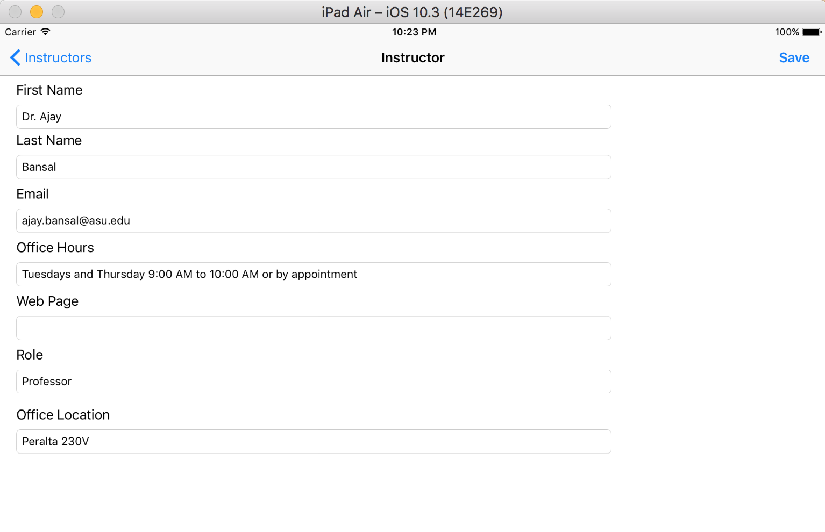
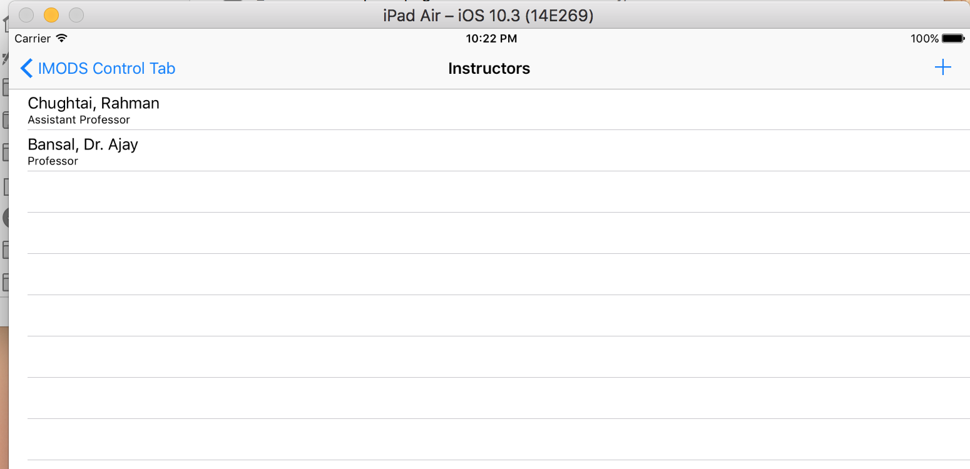
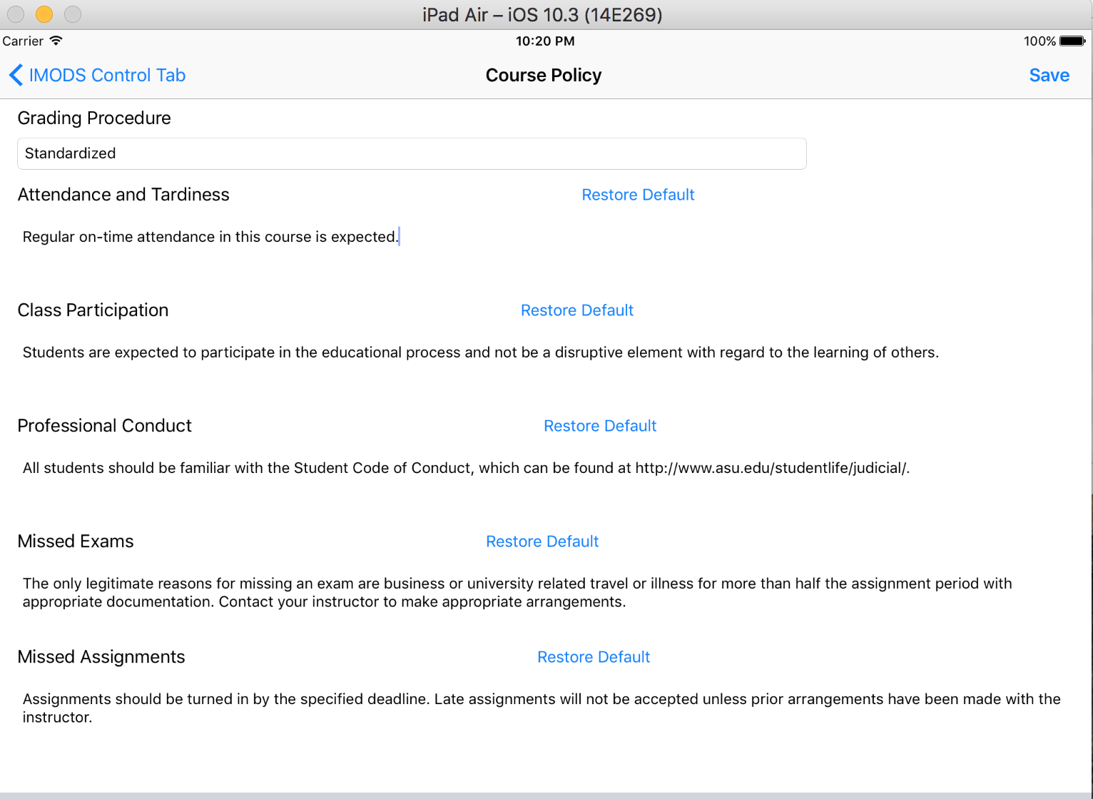
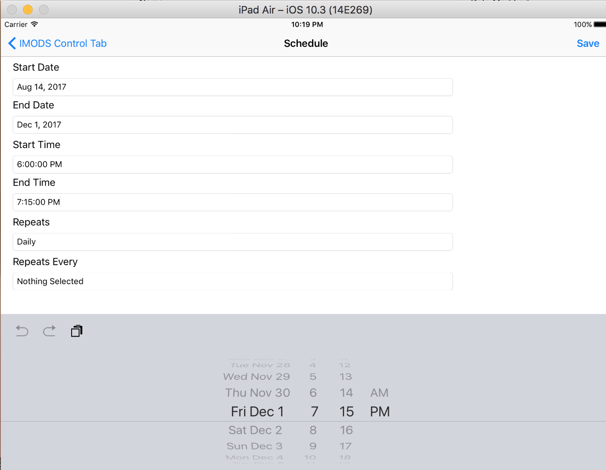





Design and Development of IMOD System for Mobile Devices
DESIGN AND DEVELOPMENTAL ACTIVITIES
IMODSTM Mobile is a lightweight mobile based tool created to guide STEM educators through an outcome-based education process.
Inception: Understanding the existing features of IMODS Web Application and translate it for the Mobile Environment.
IMPLEMENTATION
13
14
15
1
Design: Defining User Experience (UX), General Layout, Screen Flow and UI Mock-ups. Identifying the various components of MVC Model (Model View Controller) and Database Design.
12
Development: Realizing Design into Reality by implementing the various components of the Design.
2
11
Stabilization: Process of working on issues / bugs and changes just not pertaining to functional completeness but also with respect to the Usability and Performance.
3
Deployment: Final Delivery of the Mobile Application to the Stakeholders.
10
NAVIGATION DIAGRAM
4
Course Details
9
Course Description
Schedule
8
7
6
5
Welcome Page
IMODS Control Tab
Course Policy
Performance
Instructors
Instructor Detail
Content
Objectives
Objective Detail
Condition
Main Content
Main Content Detail
Criteria
TECHNOLOGIES USED
Graduate Student: Sohan Madhav Bangaru (Sohan.Bangaru@asu.edu)
Faculty Mentor: Prof. Srividya Bansal (Srividya.Bansal@asu.edu)

